Slide 1
TEMPO and PANDORA
Jay Herman, Alexander Cede, Elena Lind, Nader Abuhassan, Maria Tzortziou
Pandcora observations of NO₂ when clouds are present
Time Dependence of Total Column NO₂
From: Underestimation of Column NO₂ Amounts from the OMI Satellite Compared to Diurnally Varying
Ground-Based Retrievals from Multiple Pandora Spectrometer Instruments, AMTD, 2019

Slide 2
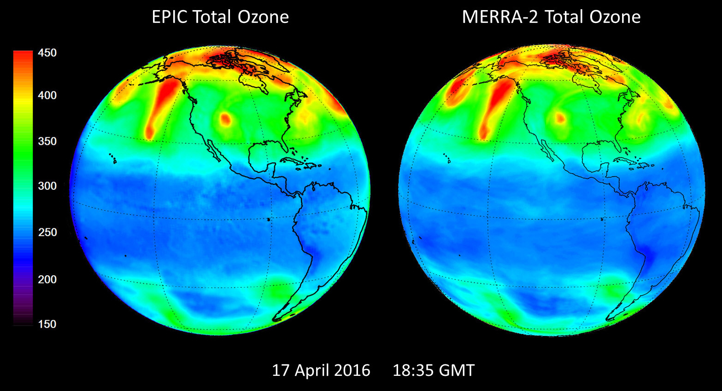

Slide 3
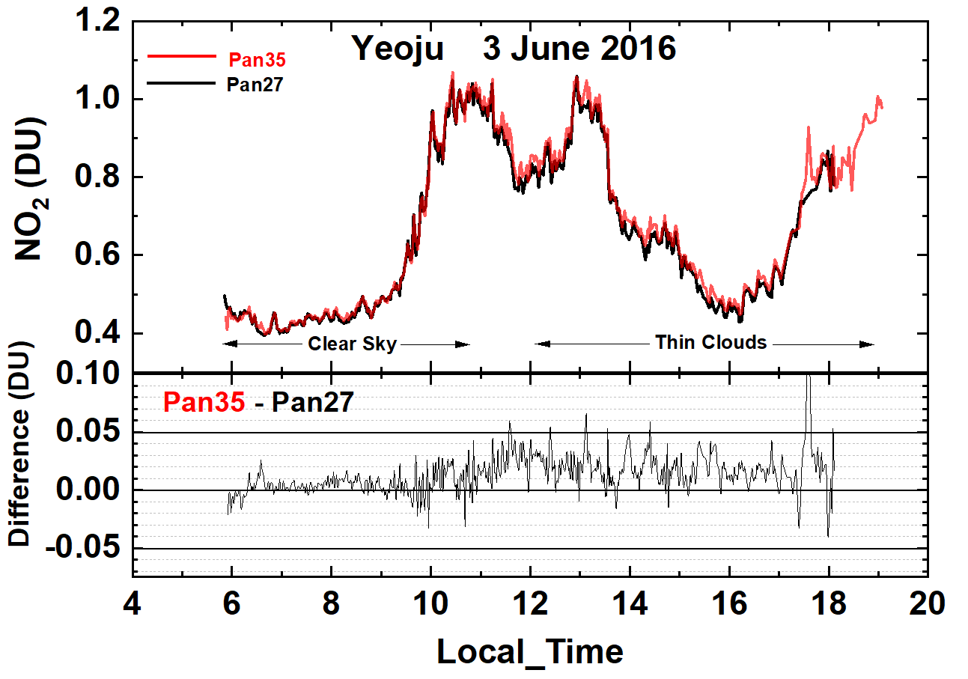
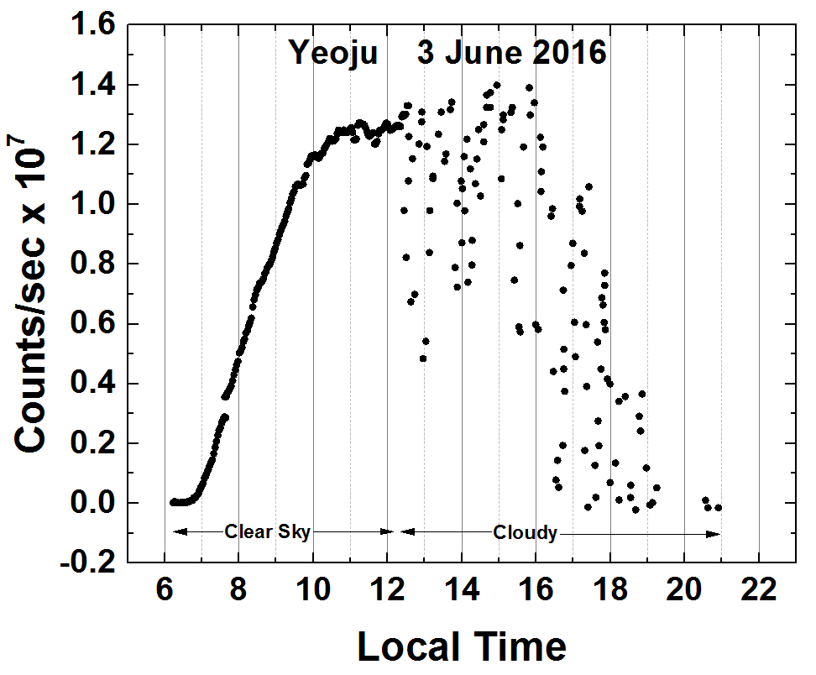
C(NO₂) amounts from Pandora 27 and 35 in Yeoju, Korea during 3 June 2016 and their difference |Pan35 – Pan27| < 0.05 DU.
Pandora 35 estimate of cloud or aerosol reduced measured counts/second at approximately 500 nm.

Slide 4
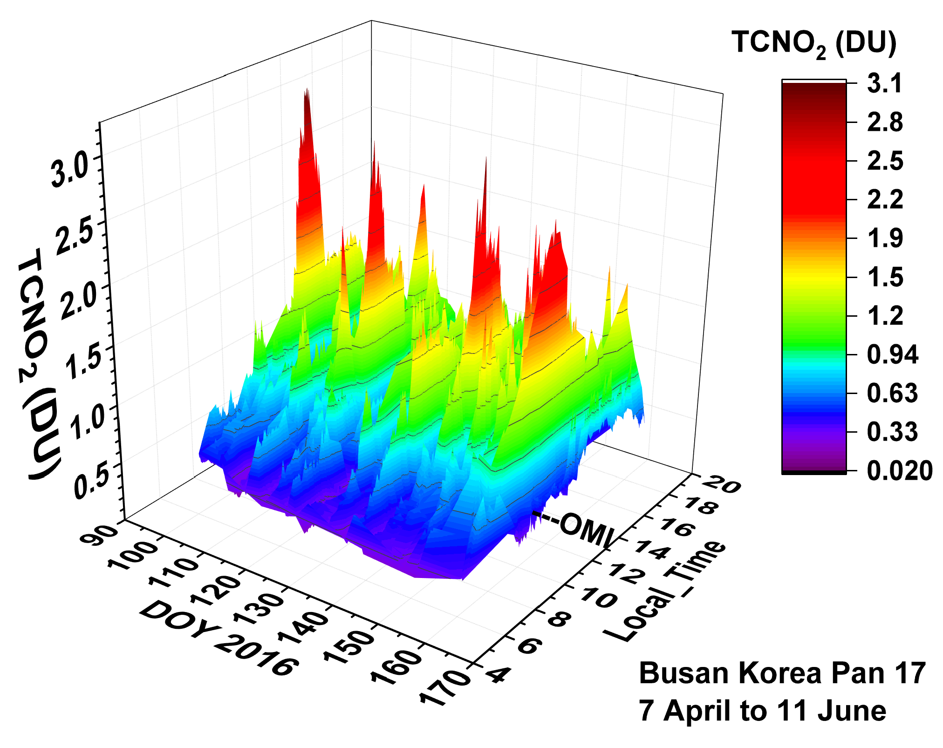
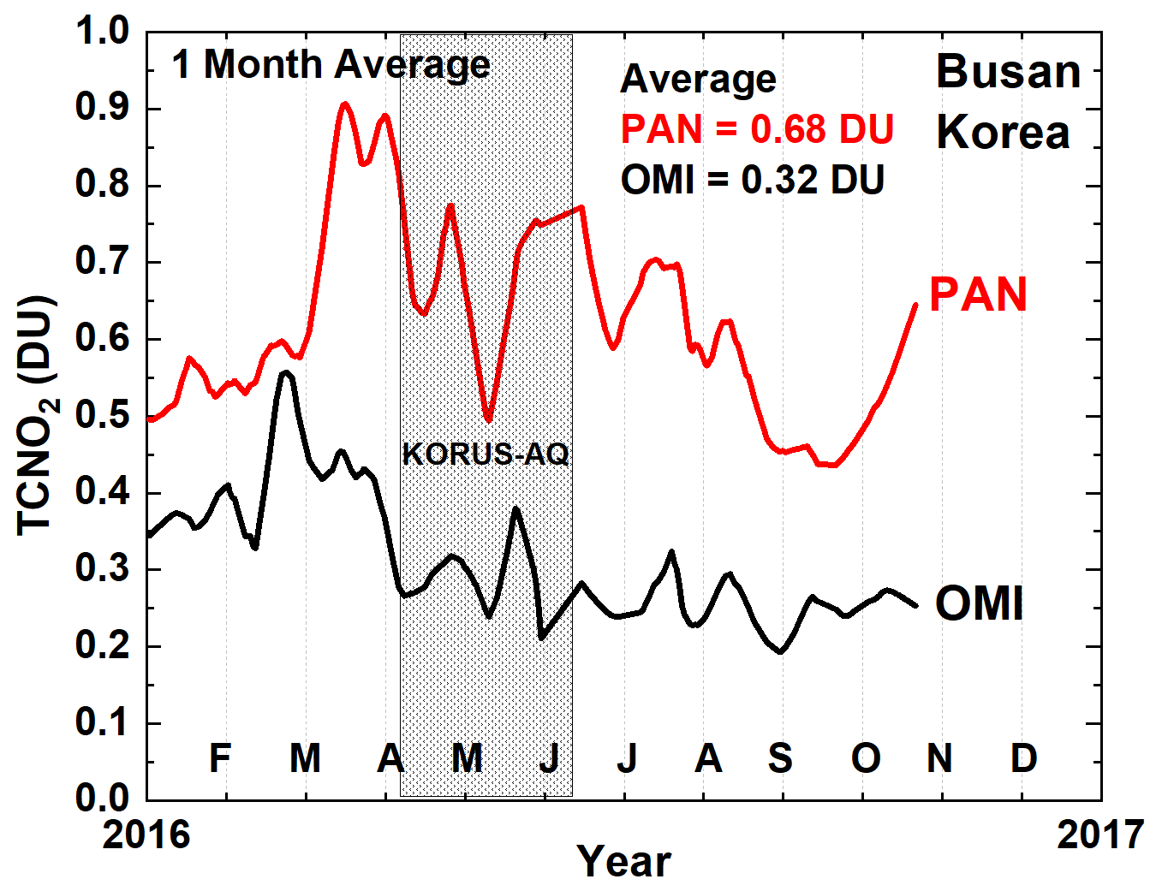
Diurnal variation of TCNO₂ measured at Pusan University in Busan South Korea
Monthly average values of TCNO₂ for OMI and PANDORA at OMI overpass times

Slide 5
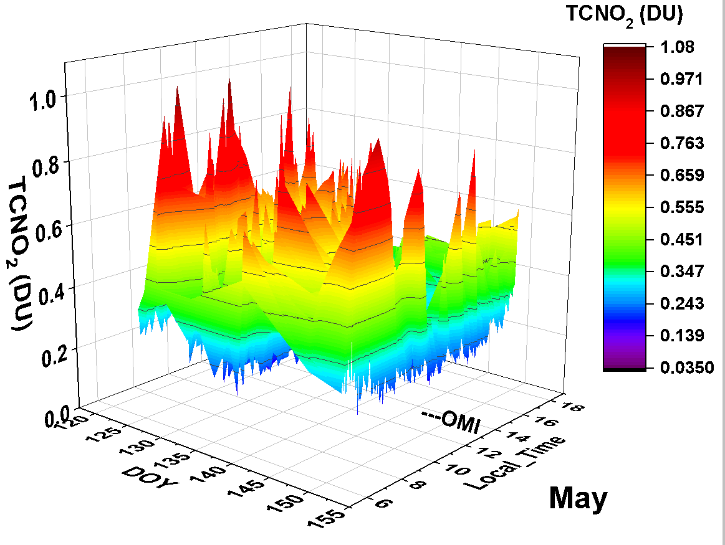
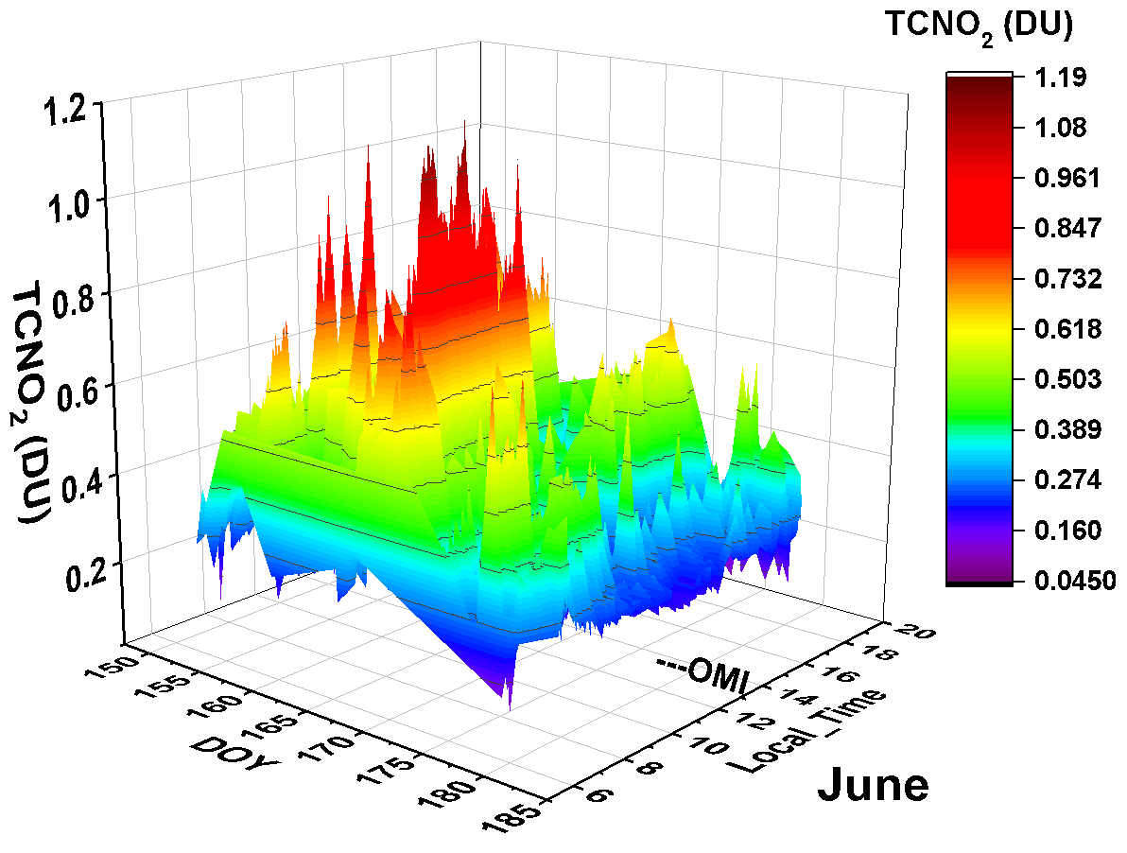
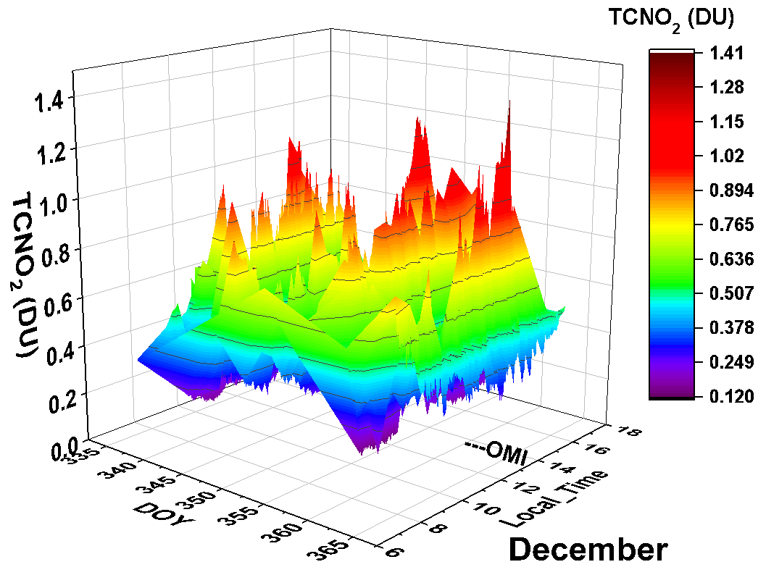
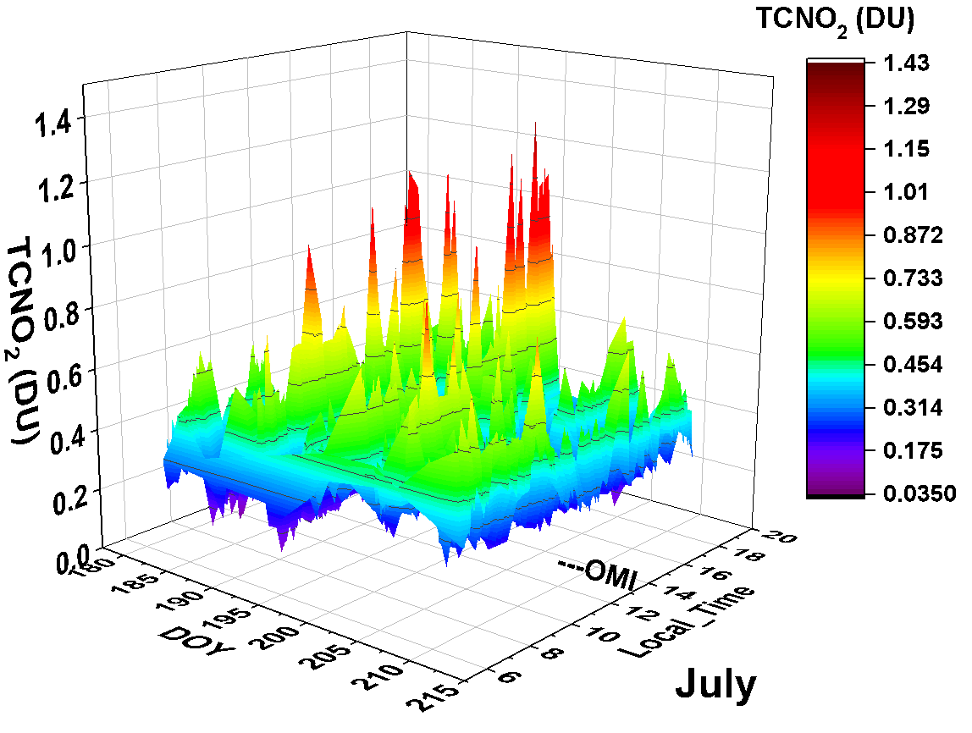
NASA Headquarters
Washington
DC

Slide 6
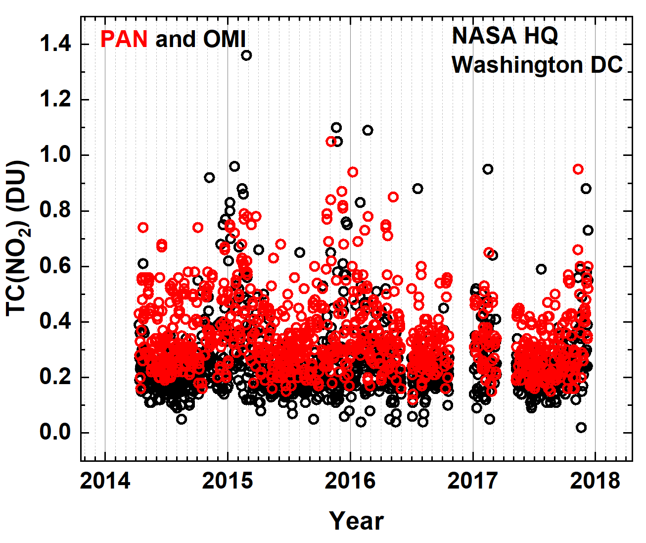
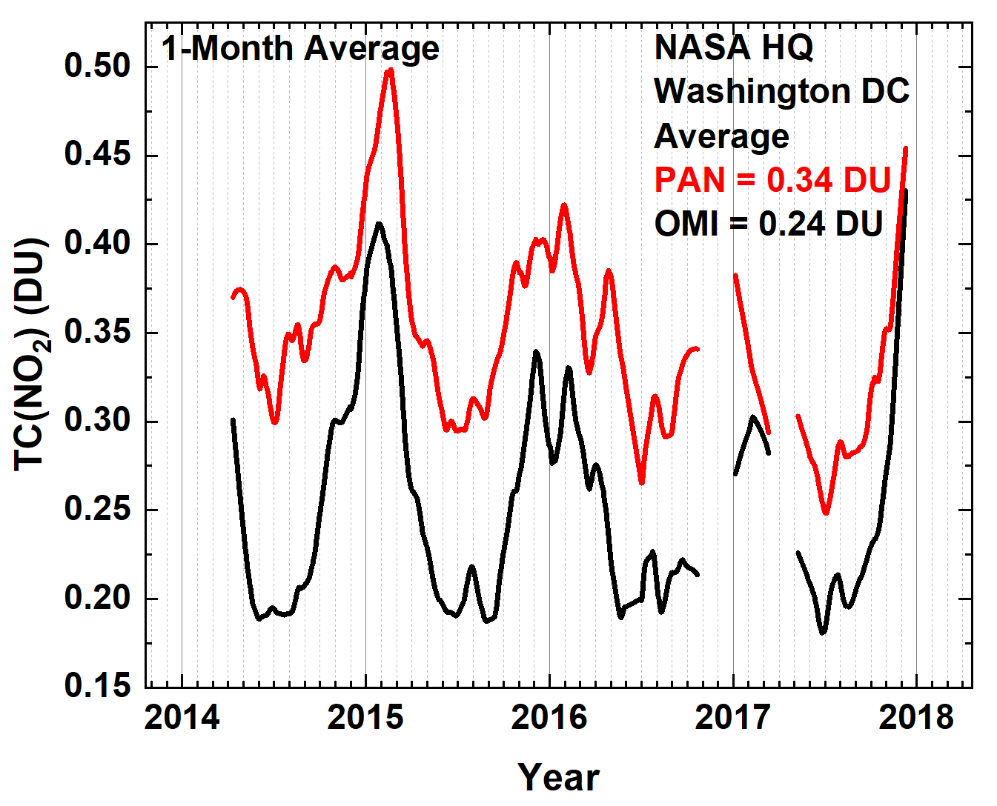
PANDORA compared to OMI. Extended TCNO₂ overpass time series for NASA Headquarters, Washington DC

